Slide 1
Senior Design: Low Noise Amplifier for Photoacoustic Imaging
sdmay-25-16
Advisor: Manojit Pramanik
Technical Contact: Avishek Das
Ethan Hulinsky
Jonathan Wetenkamp
Ryan Ellerbach
Yash Gaonkar

Slide 2
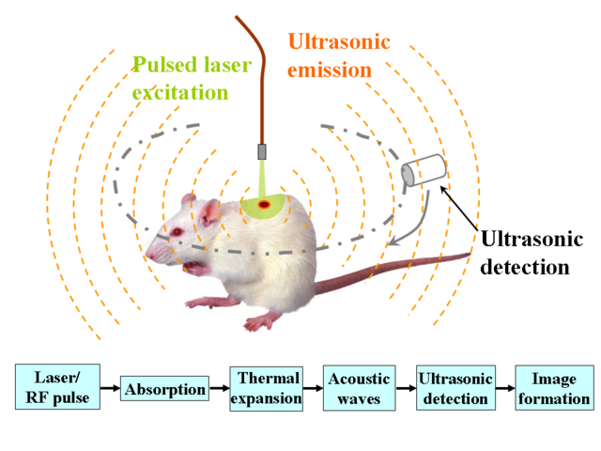
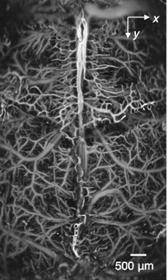
Photoacoustic Tomography Overview
Weak signals
High noise levels
Amplifier solves these problems
PC
(imaging software)
Amplifier

Slide 3
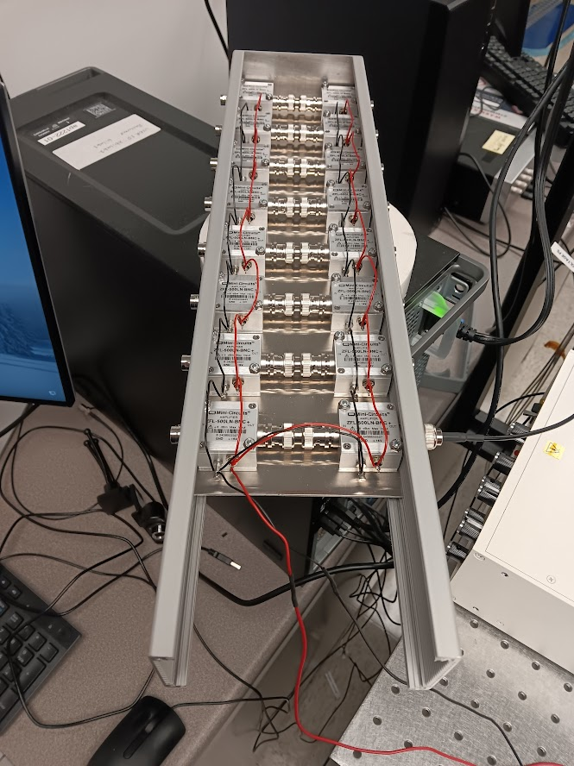
Our GOAL
Boost Signal Strength: Use pure DC battery power to minimize noise.
Compact & Modular Design: Multi-channel scalability for seamless integration.
Enhanced Usability: Improve performance and imaging quality.

Slide 4
USER NEEDS
Primary Users:
Engineers
Postdoc researcher
Medical Professionals
Key Requirements:
High gain with Minimal noise
Modular, compact and user-friendly
Integration with existing PAT systems

Slide 5
Project Requirements
Low noise: Less than 2 dB
Low input impedance: 50 Ohms
Bandpass filtering: 1 MHz-20 MHz (Constraint)
Gain greater than 30 dB per channel (Constraint)
Output voltage cannot exceed 10 V
Handling input voltages from 100 μV to 10 mV
10 V power supply

Slide 6
Project Timeline

Slide 7
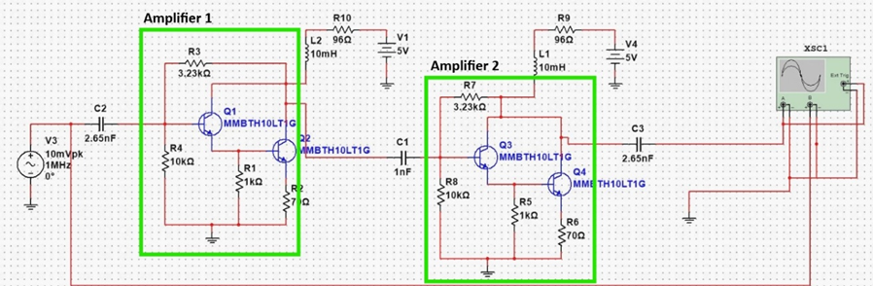
Initial Testing Schematic
provided to us by our project contact

Slide 8
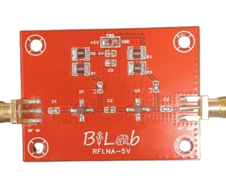
Prototype Board
This is the prototype we did testing on during out first semester of our capstone Project

Slide 9
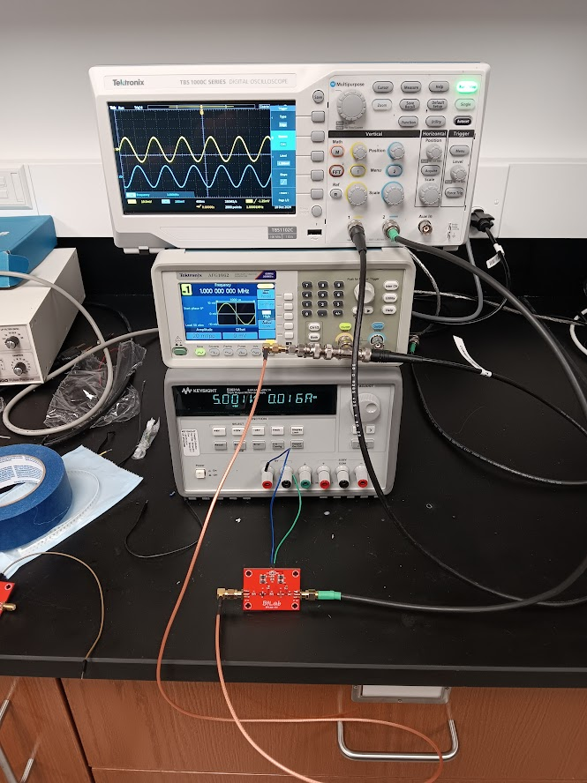
TESTING THE PROTOTYPE

Slide 10
Findings From testing
We were able to get the gain to match the datasheet
1
We have found a solution to fix the clipping at higher inputs
2

Slide 12
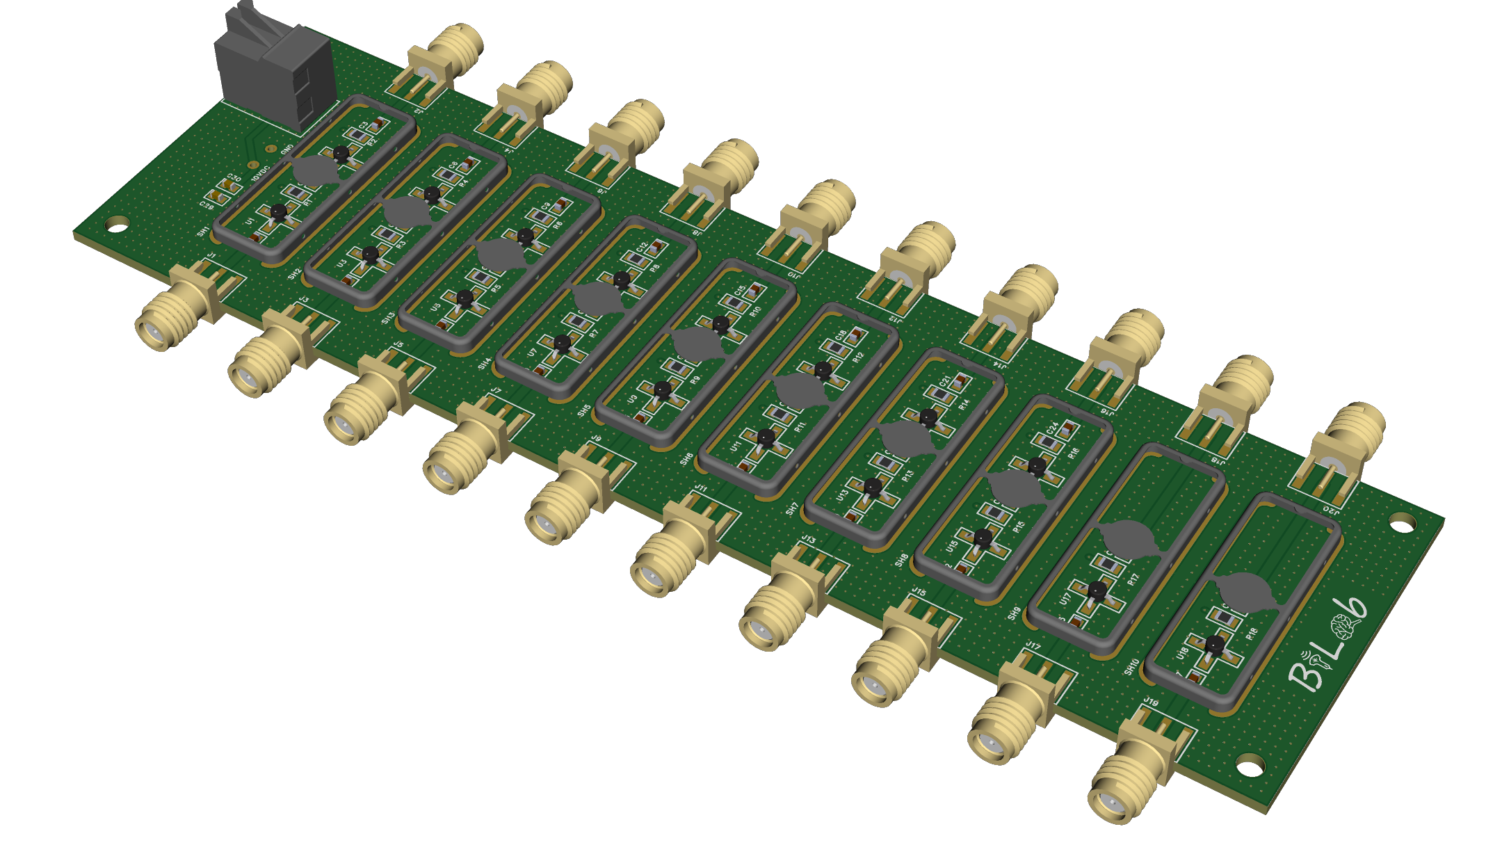
Test Board

Slide 13
Results/conclusions after Testing revision board 1
Increase grounding
SMA connectors
EM shields
GND pads of amplifiers
Add other functionality
Connection to battery power
Switch to control power input

Slide 14
Final Schematic

Slide 15
Final 3d model

Slide 16
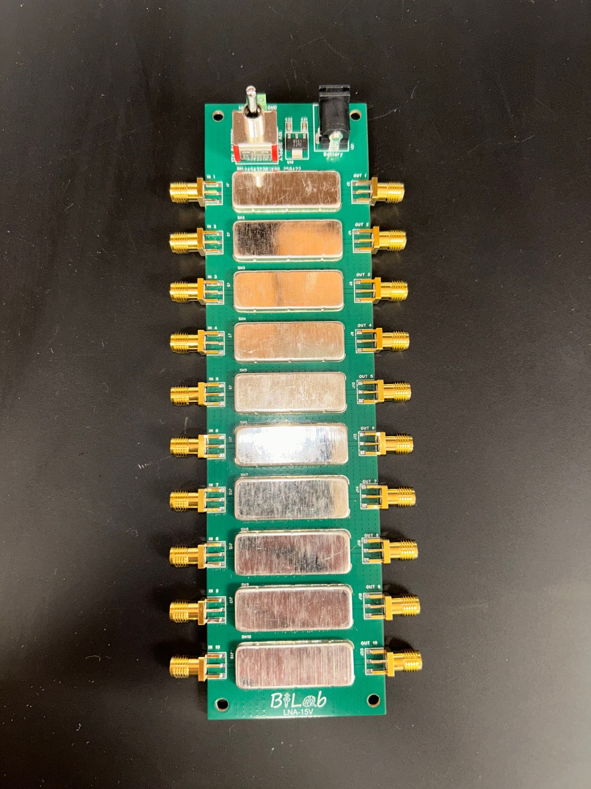
Final PCB
Solder paste and stencil
Manual component placement
Reflow oven

Slide 17
Testing
Gain
Transient Signal Integrity
Cross-Talk
Bias Voltage
Linearity

Slide 18
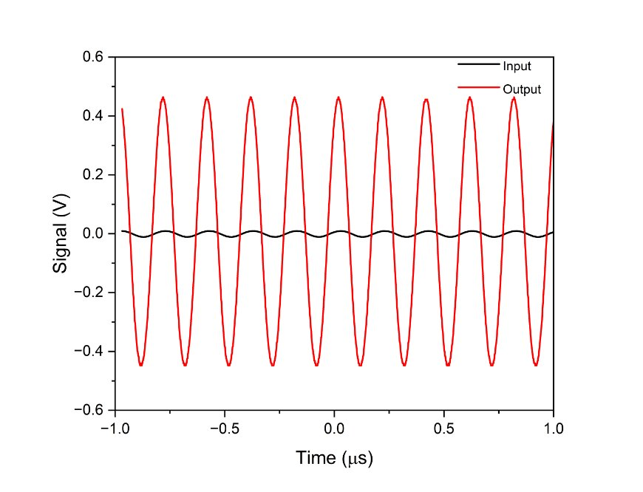
Output vs Input
Signal integrity was kept through amplification

Slide 19
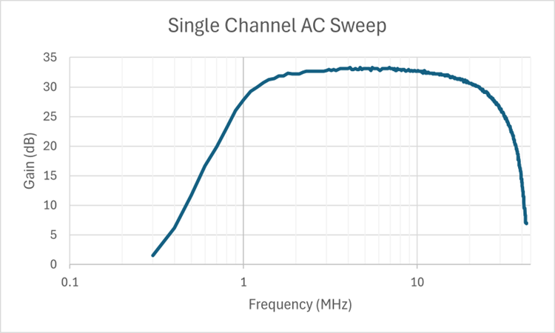
Gain
Over 32dB passband
Gain can be increased by cascading channels

Slide 20
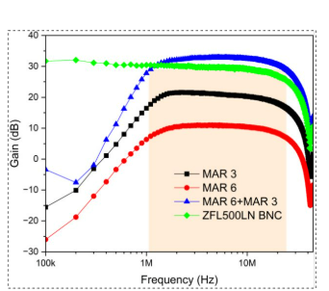
Gain comparison
1 channel of the amplifier we designed had the highest Gain (~32.7dB)
ZFL500LN is the prototype provided to us by the client

Slide 21
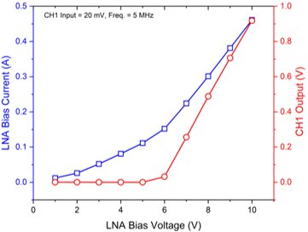
Bias Voltage
Optimal region for amplifier operation

Slide 22
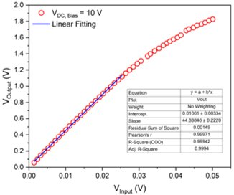
Linearity
The amplifier shows excellent linearity
Excellent for signal Processing

Slide 23
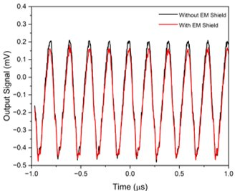
Cross-Talk
Crosstalk between the channels with the EM shield vs without the EM shield

Slide 24
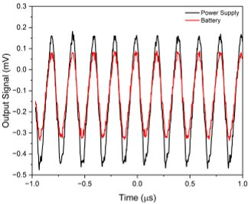
Power Supply Vs Battery
Noise in the power plane of the board with the power supply vs the battery.

Slide 25
Enclosure and Final Product

Slide 26
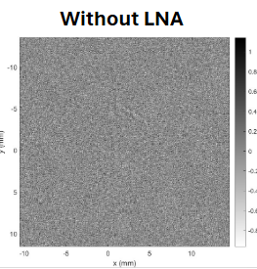
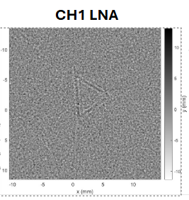
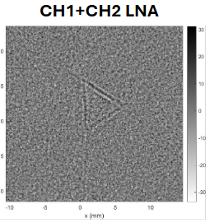
Testing Amplifier with PAT device

Slide 27
Future Work
Could implement 3 stages to increase gain
Changing blocking capacitors may allow bandwidth to be increased

Slide 28
Conclusion
We were able to design a low-noise amplifier that met all the design specs
Also designed a rechargeable battery-powered power supply that is portable.
Designed an enclosure that can house the amplifier.
Validated amplifier through extensive testing
Successfully Integrated with PAT device
Cheaper than initial prototype provided by client

